Slide 1
UNIT-II
Learning Paradigms, Linear Regression, Prediction of Linear Regression, Entropy and Cross Entropy, Logistic Regression, Logistic Regression for classification, Different Classification algorithms, Supervised and Unsupervised Learning, Classification using Support Vector Machine, Naïve Bayes, Decision trees, Ensemble Learning, Overfitting, Underfitting, Regularisation, Cross validation

Slide 2
ML and IoT
ML, a subset of artificial intelligence, aims to build computer programs with an ability to automatically learn and improve from experience without being explicitly programmed.
In this age of big data, with data being generated at break-neck speed, it isn't humanly possible to go through all of the data and understand it manually.
According to an estimate by Cisco, a leading company in the field of IT and networking, IoT will generate 400 zettabytes of data a year by 2018.
This suggests that we need to look into automatic means of understanding this enormous data, and this is where ML comes in.

Slide 3
Learning paradigms
ML algorithms can be classified based on the method they use as follows:
Probabilistic versus non-probabilistic
Modeling versus optimization
Supervised versus unsupervised
Supervised Learning
Consider a pattern: (1, 4, 9, 16, 25,...). Guess the next number ?
Learning by example
The supervised learning is used to predict, given set of inputs, either a real-valued output (regression) or a discrete label (classification).
Unsupervised Learning
Consider: you're given with eight circular blocks of different radii and colors, and you are asked to arrange or group them in an order. What will you do?
Some may arrange them in increasing or decreasing order of radii, some may group them according to color. There are so many ways, and for each one of us, it will be dependent on what internal representation of the data we had while grouping. This is unsupervised learning, and a majority of human learning lies in this category.
The model learns by itself the underlying patterns and relationships in the data. Unsupervised learning is normally used for clustering and dimensionality reduction.

Slide 4
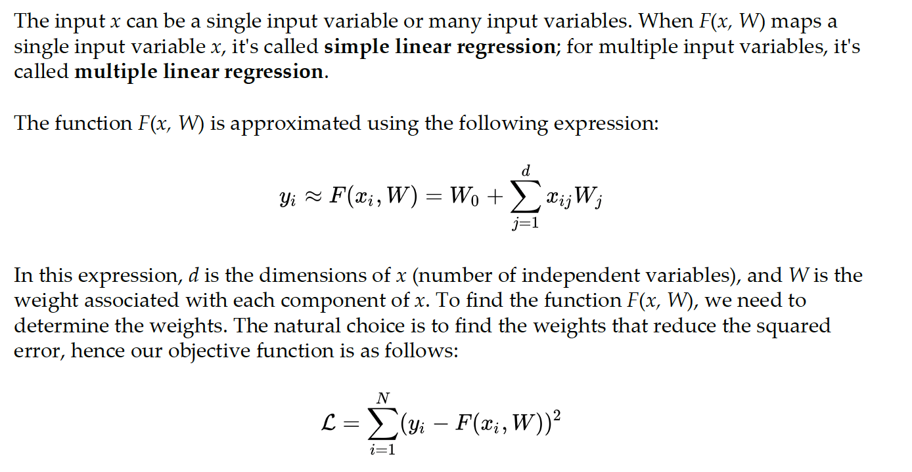
Prediction using linear regression
Linear regression is a supervised learning task.

Slide 5
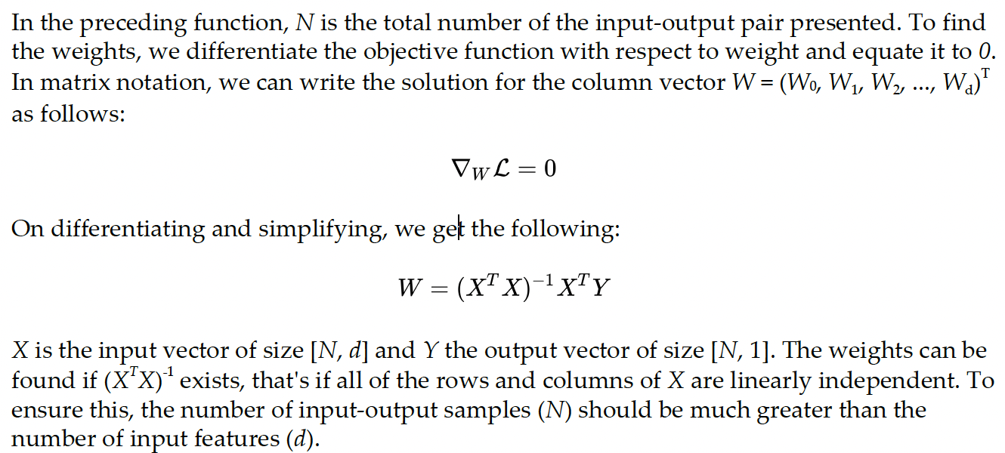

Slide 6
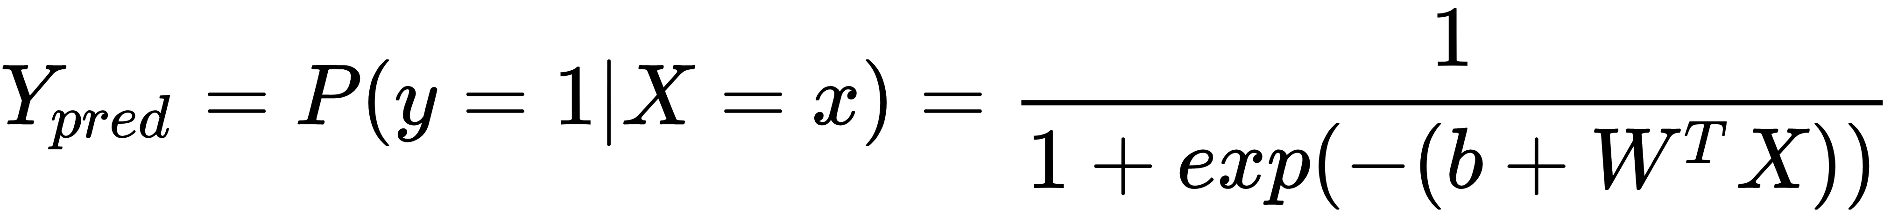
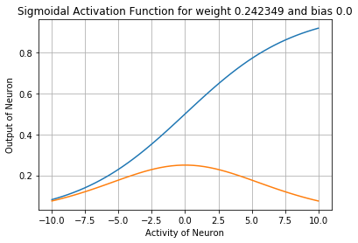
Logistic regression for classification
Logistic regression is an old classification technique.
It provides the probability of an event taking place, given an input value.
The events are represented as categorical dependent variables, and the probability of a particular dependent variable being 1 is given using the logit function:

Slide 7
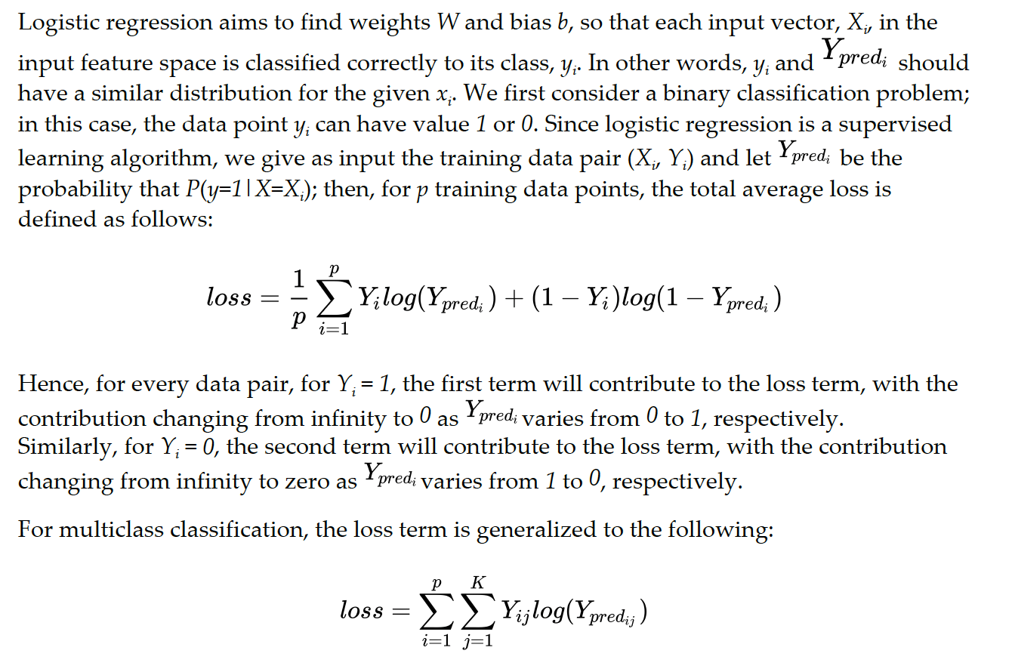
Cross-entropy loss function

Slide 8
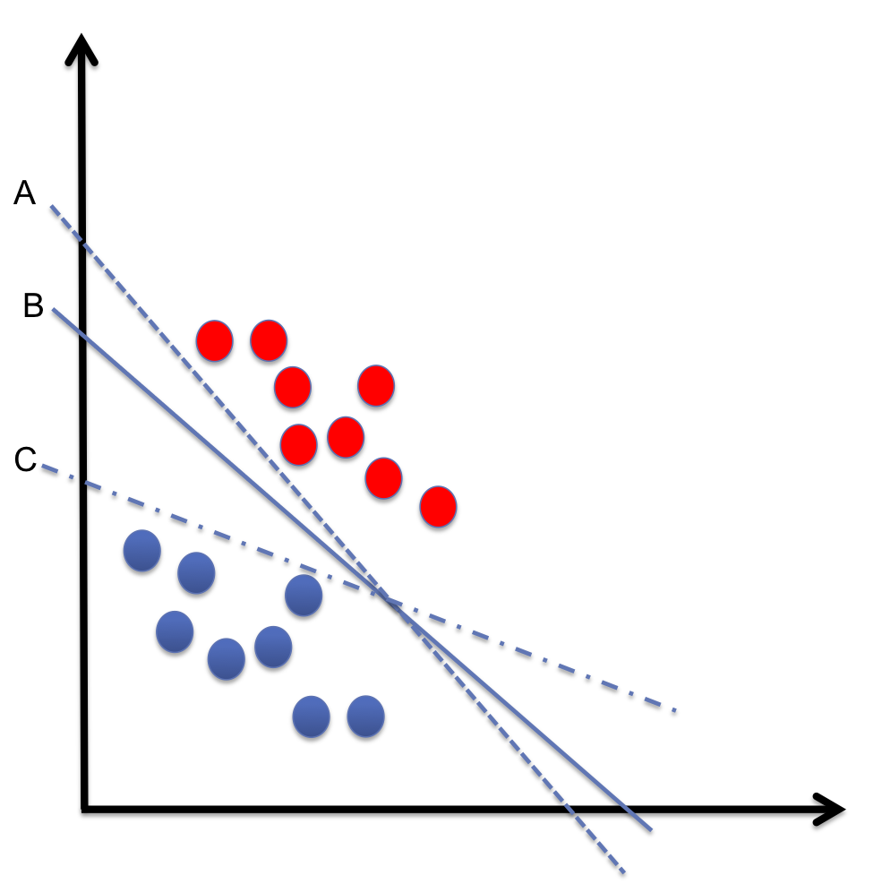
Classification using support vector machines
The main idea behind SVM is to find an optimal hyperplane with maximum margin separating the two classes.
If the data is linearly separable, the process of finding the hyperplane is straightforward, but if it isn't linearly separable, then kernel trick is used to make the data linearly separable in some transformed high-dimensional feature space.
SVM is considered a non-parametric supervised learning algorithm.

Slide 9
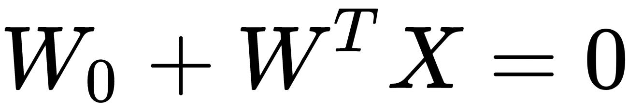
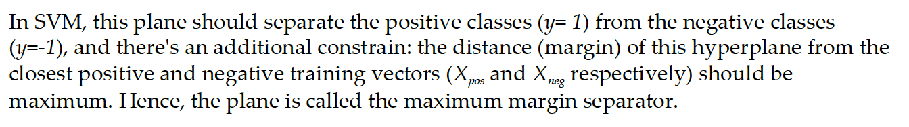
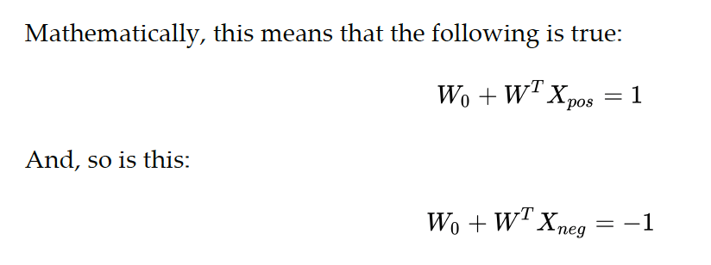
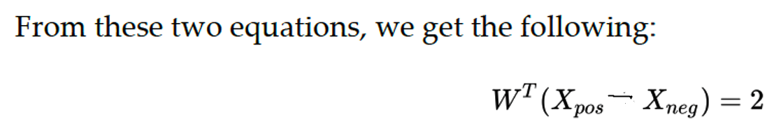
Maximum margin hyperplane
From Linear Algebra, the equation of a plane is given by the following:

Slide 10
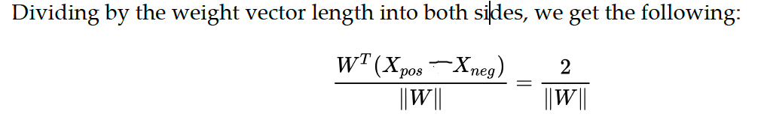
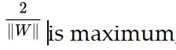
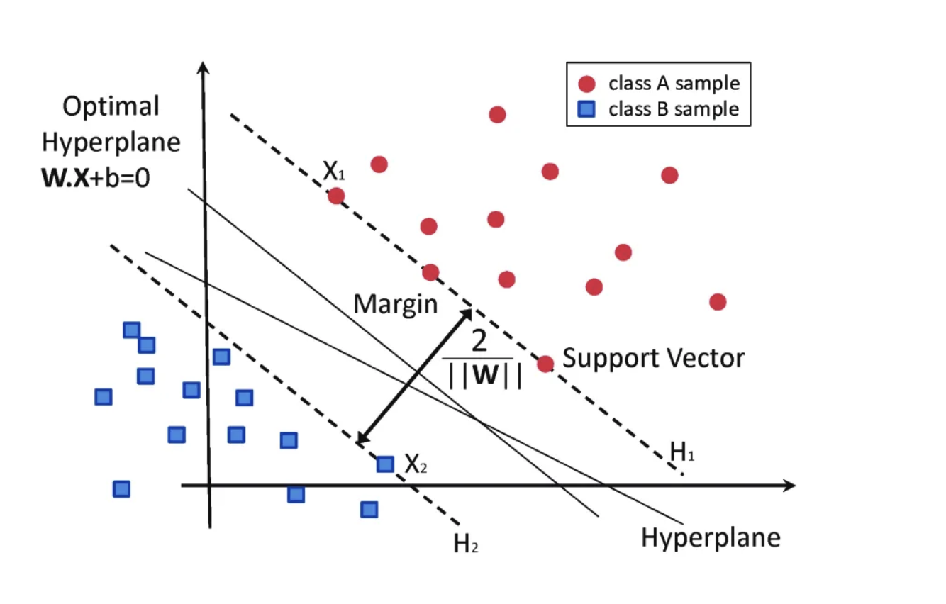
So we need to find a separator so that the margin between positive and negative support vectors is maximum, that is:

Slide 11
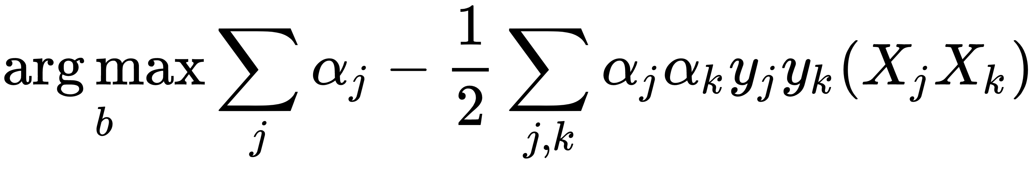
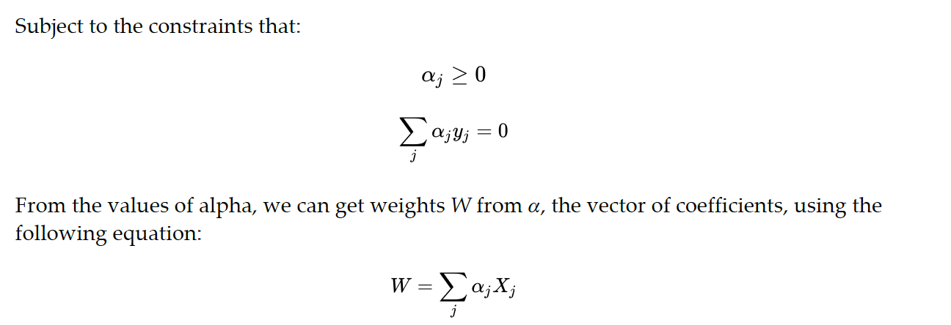
Optimal solution is calculated as:

Slide 12
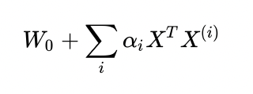
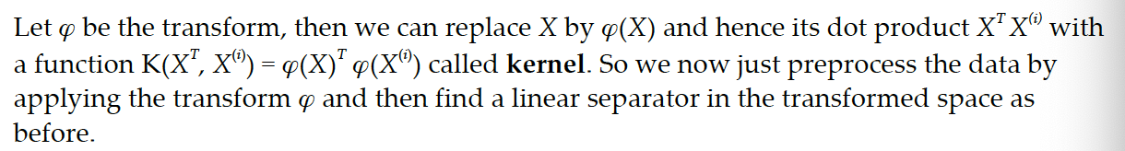
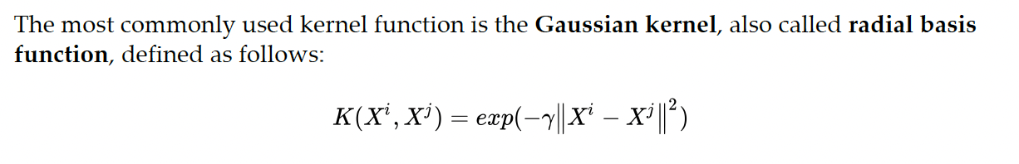
Kernel trick:
To transform the data (X) into a higher dimensional space where it's linearly separable and find a maximal margin hyperplane in that high-dimensional space.

Slide 13
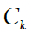
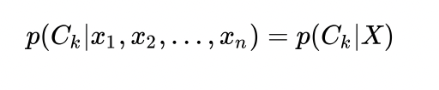
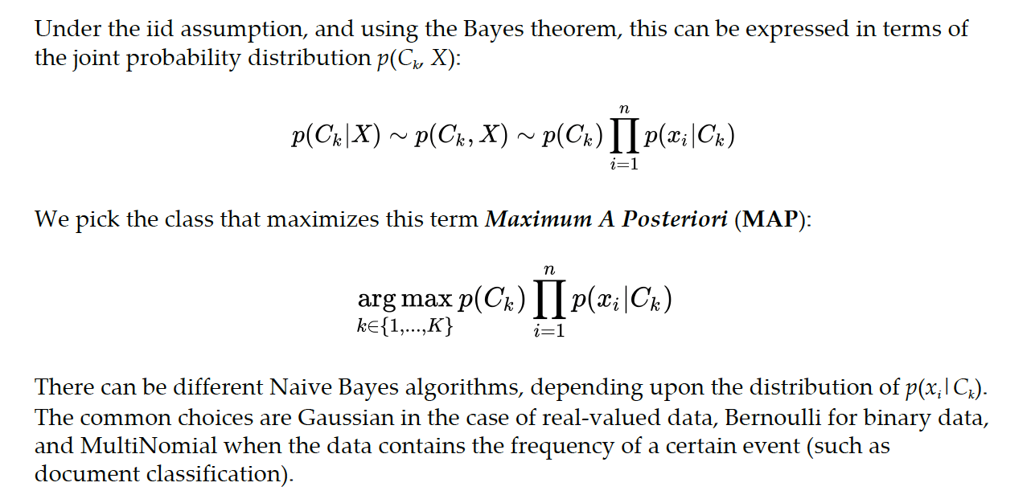
Naive Bayes
Naive Bayes is one of the simplest and fastest ML algorithms.
It's based on the Bayes probability theorem.
One important assumption that we make in the case of the Naive Bayes classifier is that all of the Features of the input vector are independent and identically distributed.
The goal is to learn a conditional probability model for each class in the training dataset:

Slide 14
Decision trees
In decision trees, we build a tree-like structure of decisions; we start with the root, choose a feature and split into branches, and continue till we reach the leaves, which represent the predicted class or value.
The algorithm of decision trees involves two main steps:
Decide which features to choose and what conditions to use for splitting
Know when to stop
Let's understand it with an example. Consider a sample of 40 students; we have three
variables: the gender (boy or girl; discrete), class (XI or XII; discrete), and height (5 to 6 feet; continuous).
Eighteen students prefer to go to the library in their spare time and rest prefer to play. We can build a decision tree to predict who will be going to the library and who will be going to the playground in their leisure time.

Slide 15
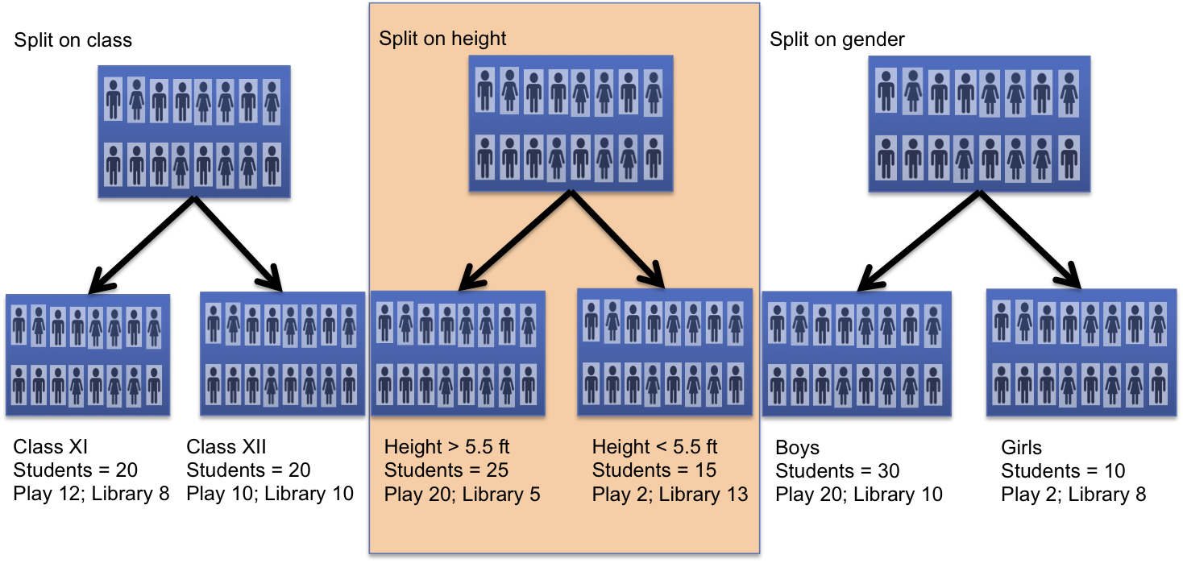

Slide 16
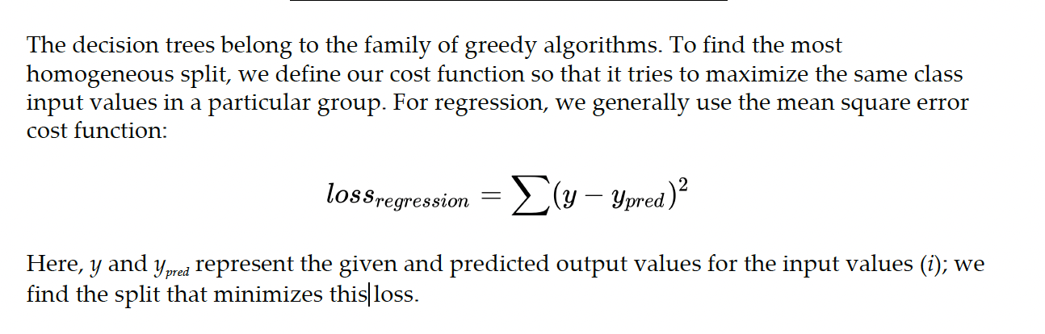
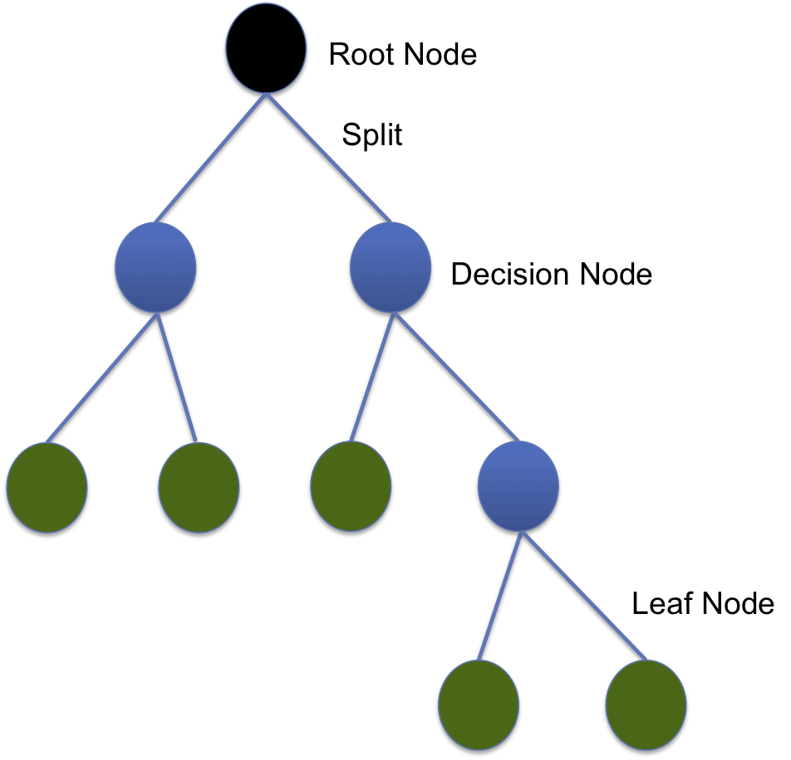

Slide 17
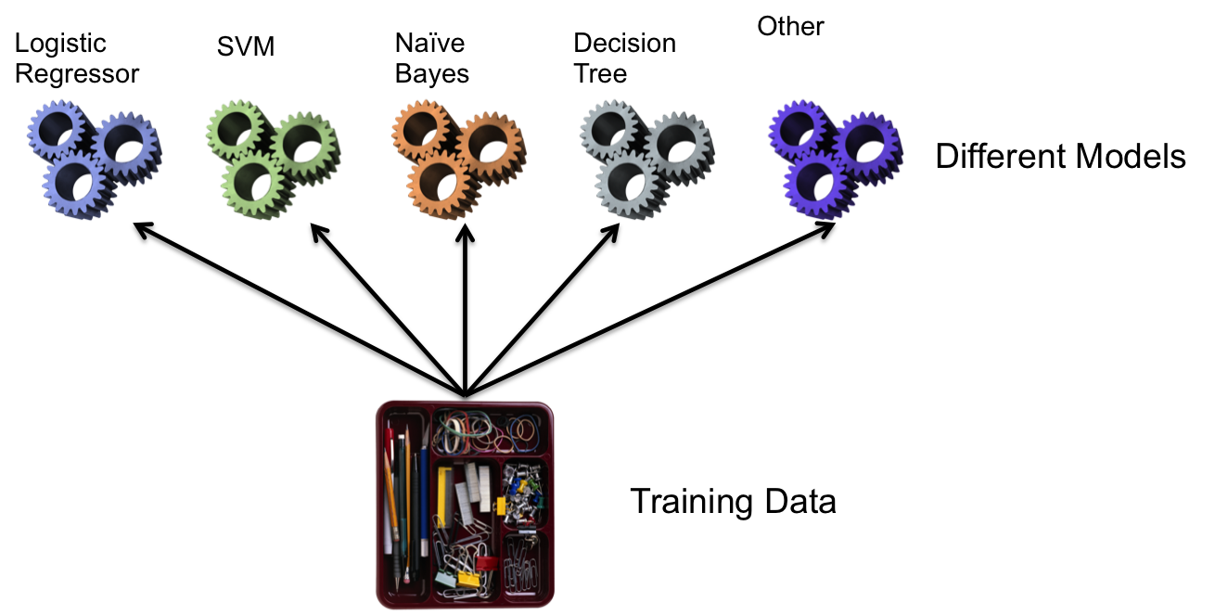
Ensemble Learning
The training of different models can take place either sequentially or in parallel. There are various ways to implement ensemble learning: voting, bagging and pasting, and random forest.

Slide 18
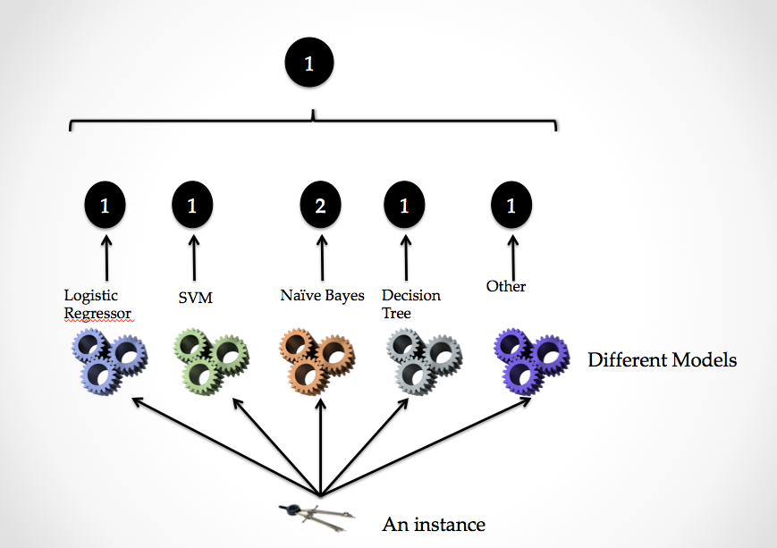
Voting classifier
The voting classifier follows the majority; it aggregates the prediction of all the classifiers
and chooses the class with maximum votes. For example, in the following screenshot, the
voting classifier will predict the input instance to belong to class 1

Slide 19
Bagging and pasting
In voting, we used different algorithms for training on the same dataset.
We can also achieve ensemble learning by using different models with the same learning algorithm, but we train them on different training data subsets.
The training subset is sampled randomly. The sampling can be done with replacement (bagging) or without replacement (pasting)
Bagging: In it, additional data for training is generated from the original dataset using combinations with repetitions. This helps in decreasing the variance of different models.
Pasting: Since pasting is without replacement, each subset of the training data can be used at most once. It's more suitable if the original dataset is large.

Slide 20
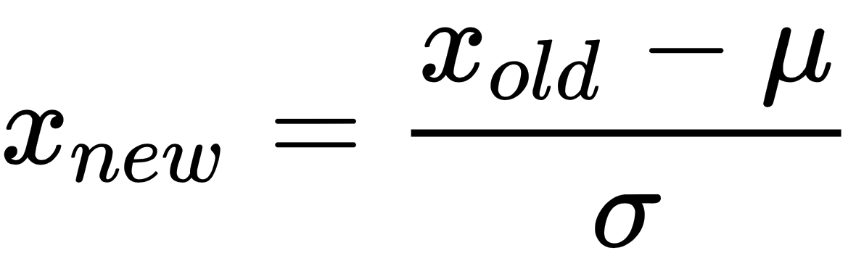
Improving your model
Feature scaling to resolve uneven data scale
The data that's collected normally doesn't have the same scale; for example, one feature may be varying in the range 10–100 and another one may be only distributed in range 2–5.
This uneven data scale can have an adverse effect on learning. To resolve this, we use the method of feature scaling (normalization). The choice of normalization has been found to drastically affect the performance of certain algorithms.
Two common normalization methods
Z-score normalization
In z-score normalization, each individual feature is scaled so that it has the properties of a standard normal distribution, that is, a mean of 0 and variance of 1. If μ is the mean and σ the variance, we can compute Z-score normalization by making the following linear transformation on each feature as follows:

Slide 21
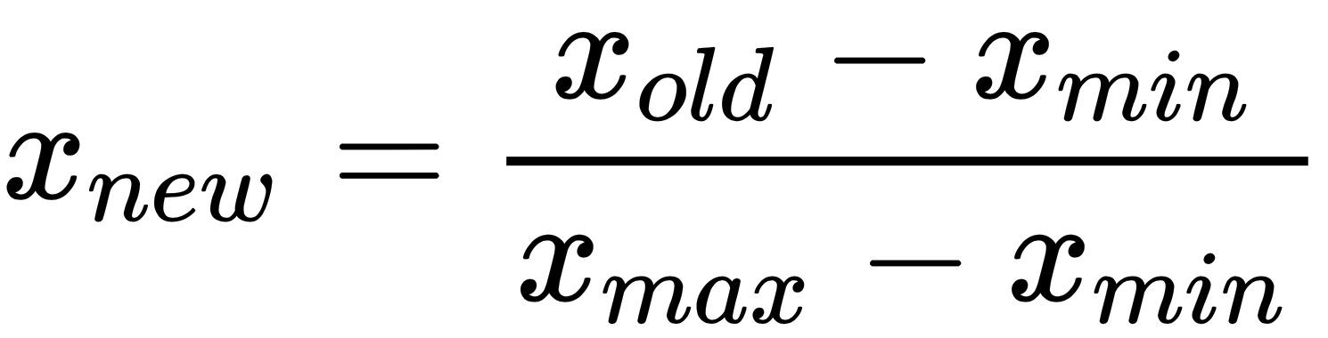
Min-max normalization
The min-max normalization rescales the input features so that they lie in the range between 0 and 1.
It results in reducing the standard deviation in the data and hence suppresses the effect of outliers.
To achieve minmax normalization, we find the maximum and minimum value of the feature (xmax and xmin respectively), and perform the following linear transformation:
Overfitting
Sometimes the model tries to overfit the training dataset; in doing so, it loses its ability to generalize and hence performs badly on the validation dataset; this in turn will affect its performance on unseen data values.
There are two standard ways to take care of overfitting: regularization and cross-validation.

Slide 22
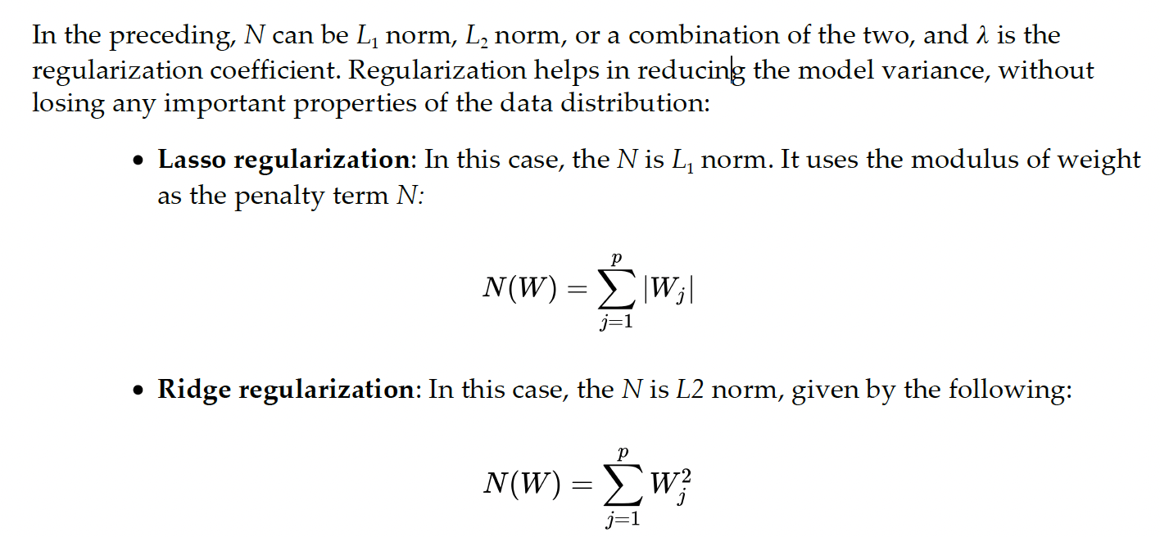
Regularization
Regularization adds a term in the loss function to ensure that the cost increases as the model increases the number of features.
Hence, we force the model to stay simpler.
If L(X, Y) was the loss function earlier, we replace it with the following:

Slide 23
Cross-validation
Using cross-validation can also help in reducing the problem of overfitting.
In k-fold cross validation, data is divided into k-subsets, called folds.
Then it trains and evaluates the model k-times; each time, it picks one of the folds for
validation and the rest for training the model.
We can perform the cross-validation when the data is less and training time is small

